Slide 1
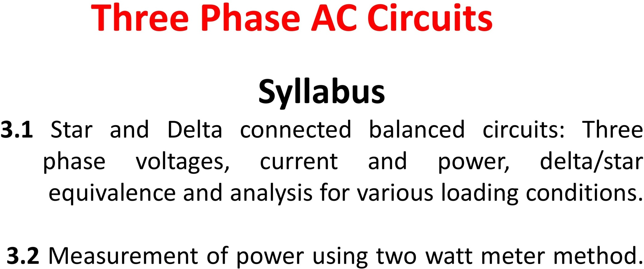

Slide 2
In single phase circuit, there will be only one phase, i.e the current will flow through only one wire and there will be one return path called neutral line to complete the circuit. So in single phase minimum amount of power can be transported.
Three phase circuit is the polyphase system where three phases are send together from the generator to the load.
Each phase are having a phase difference of 120º, i.e 120º angle electrically. So from the total of 360º, three phases are equally divided into 120º each.

Slide 3
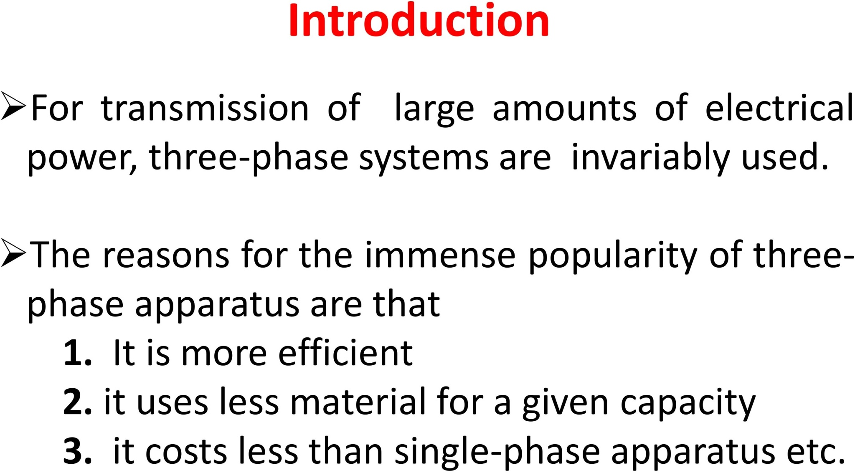

Slide 4
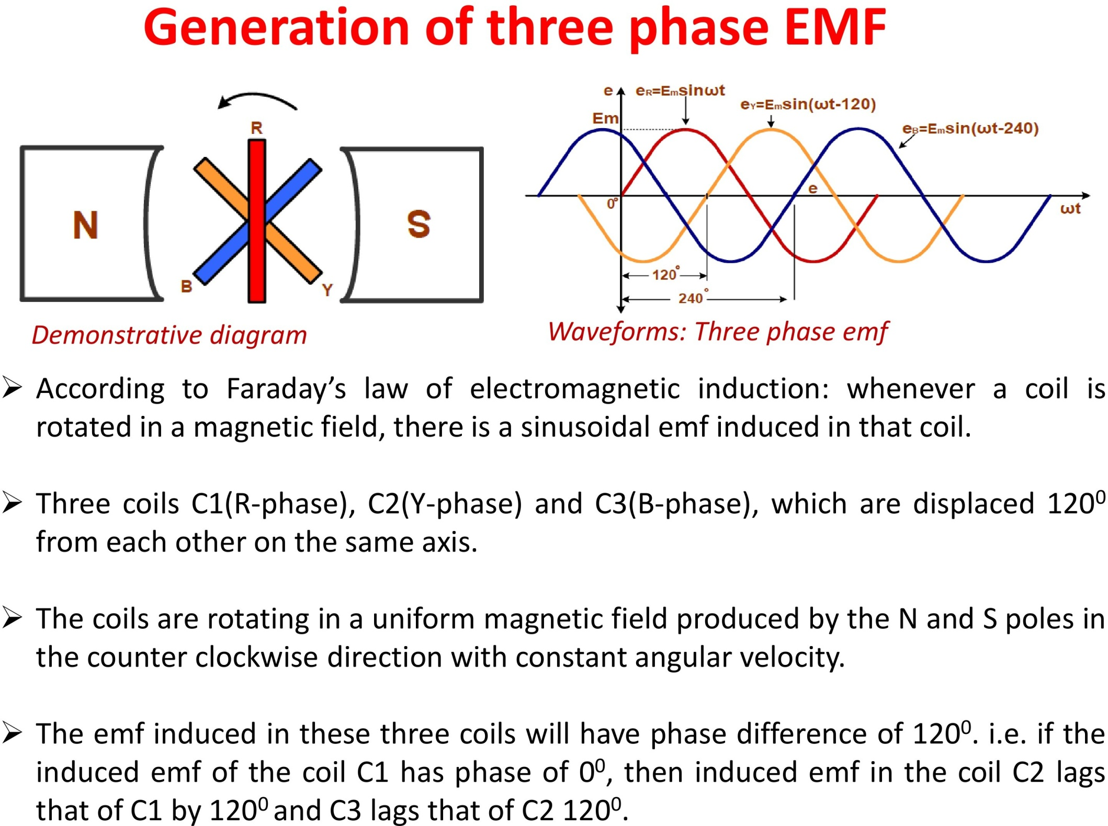

Slide 5
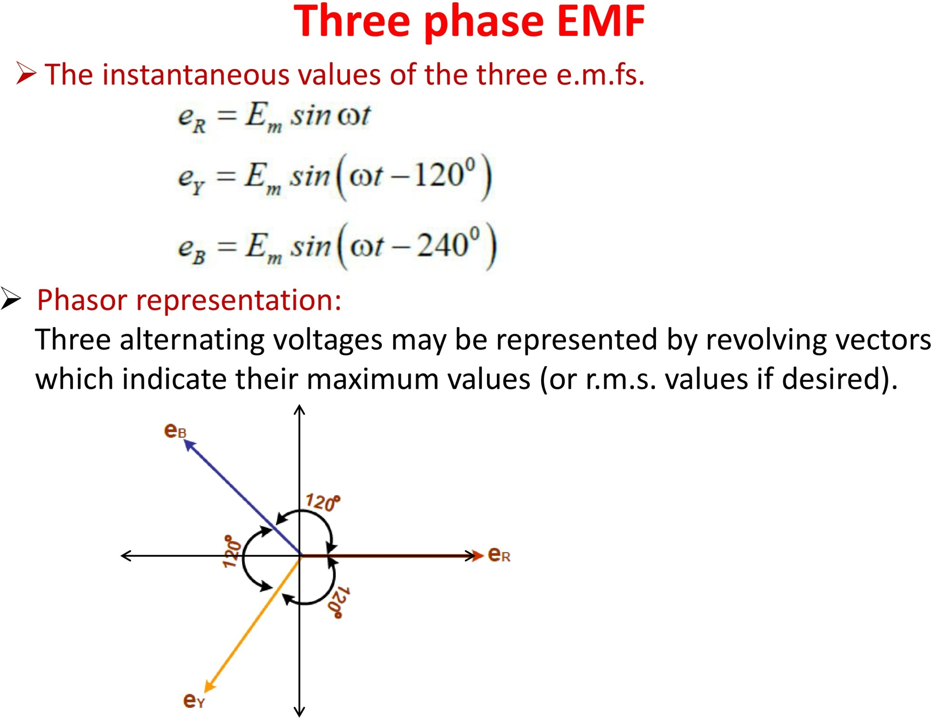

Slide 6
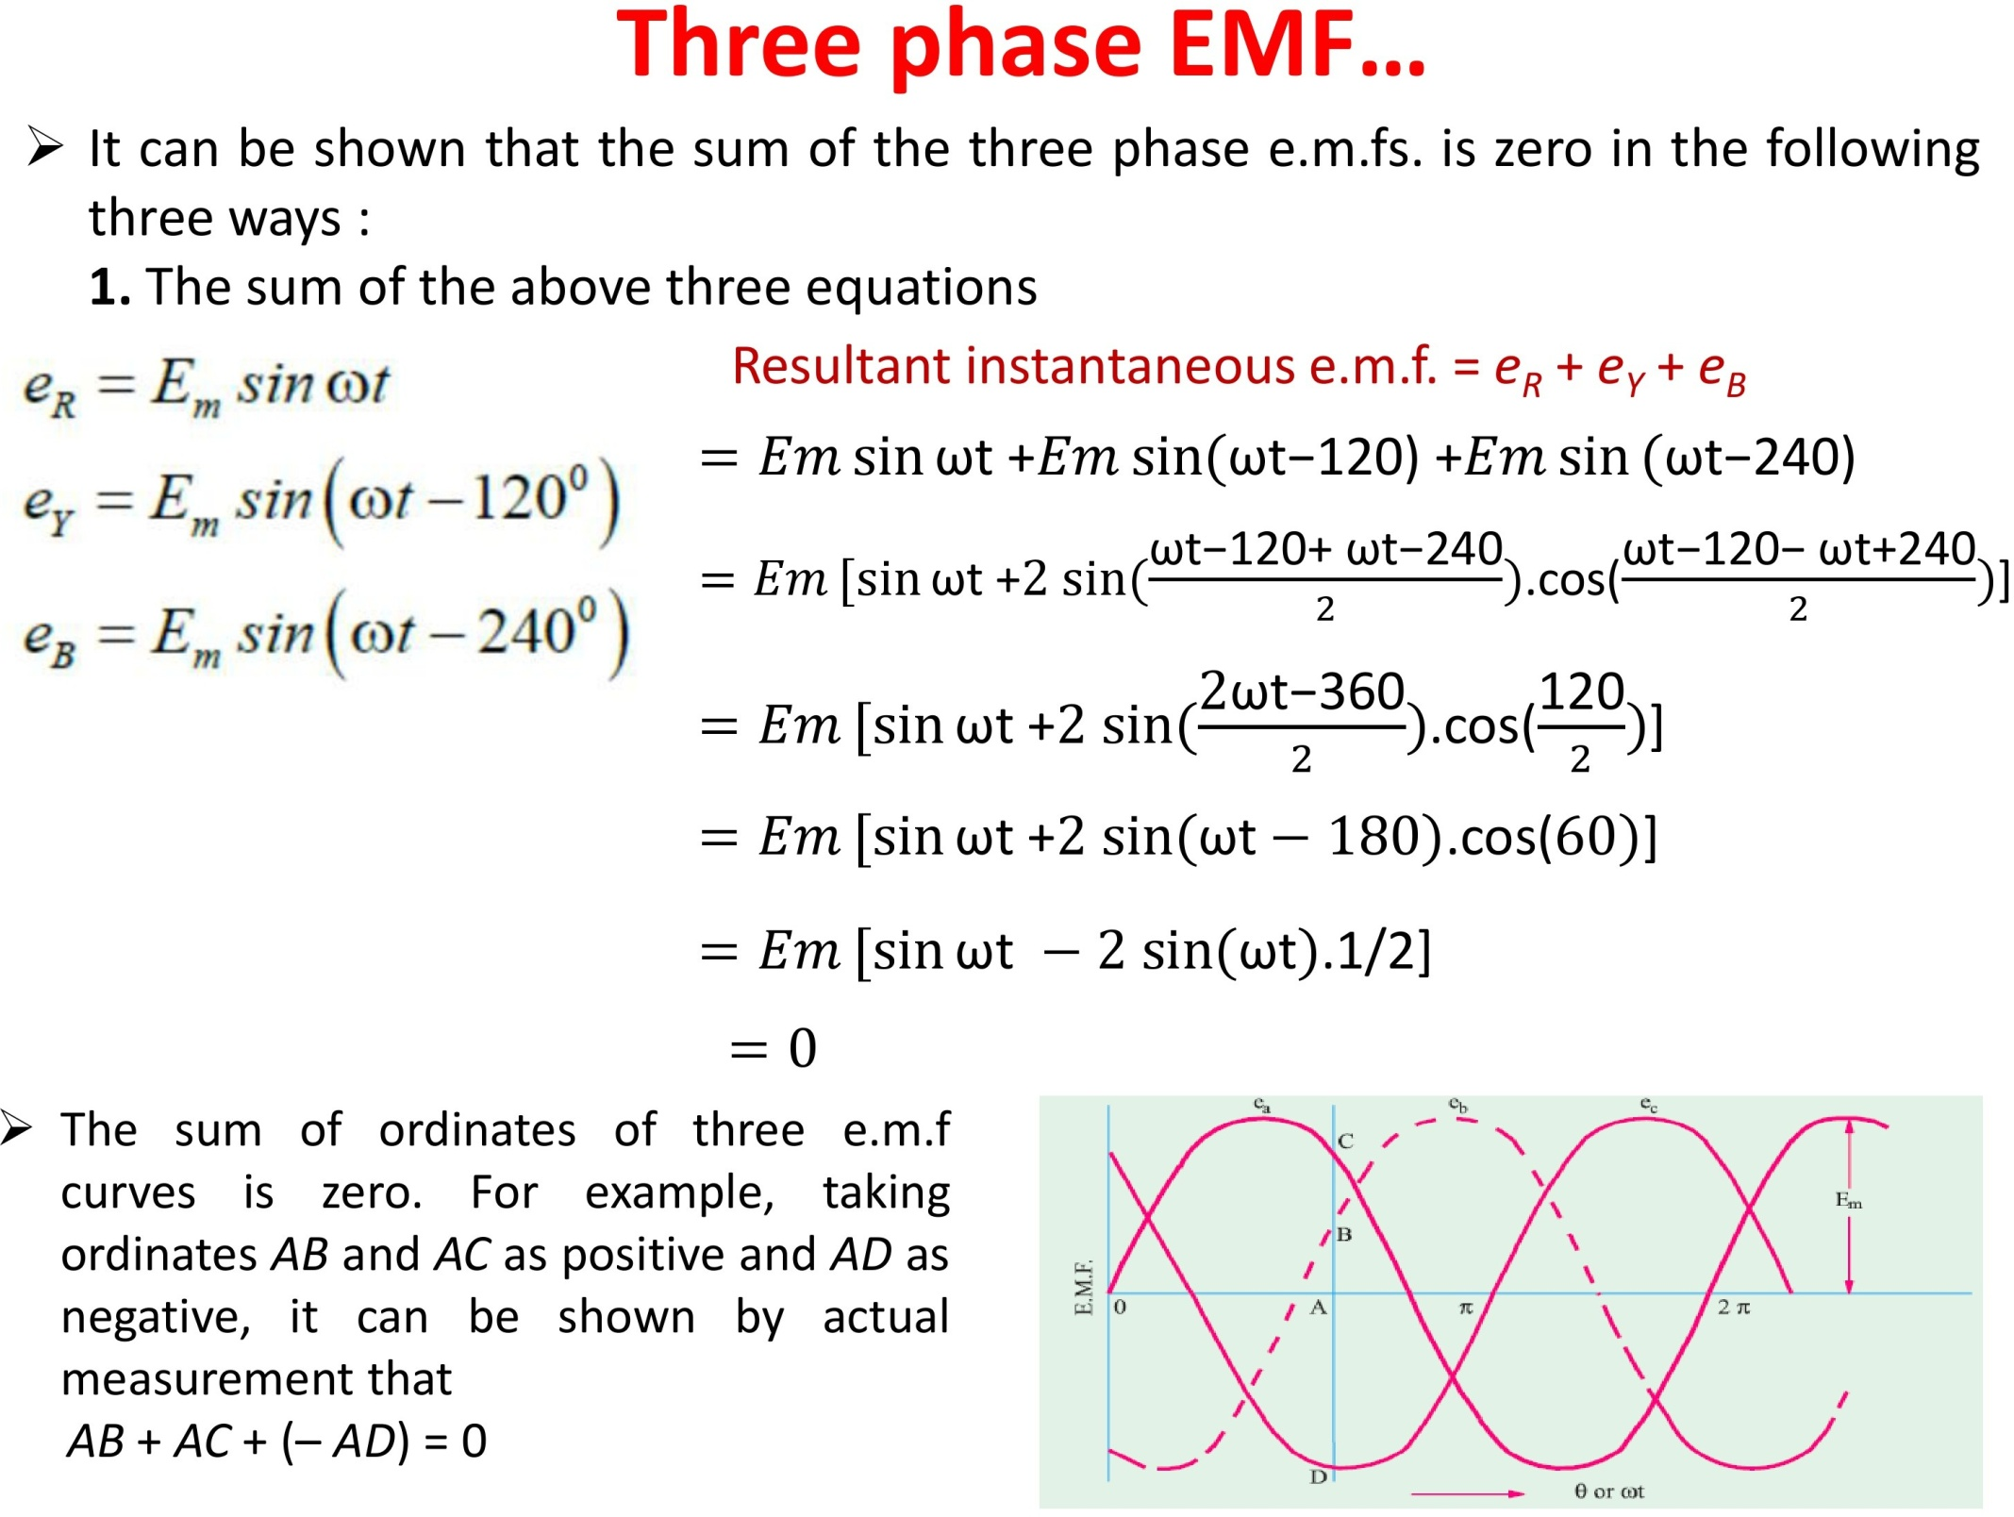

Slide 7
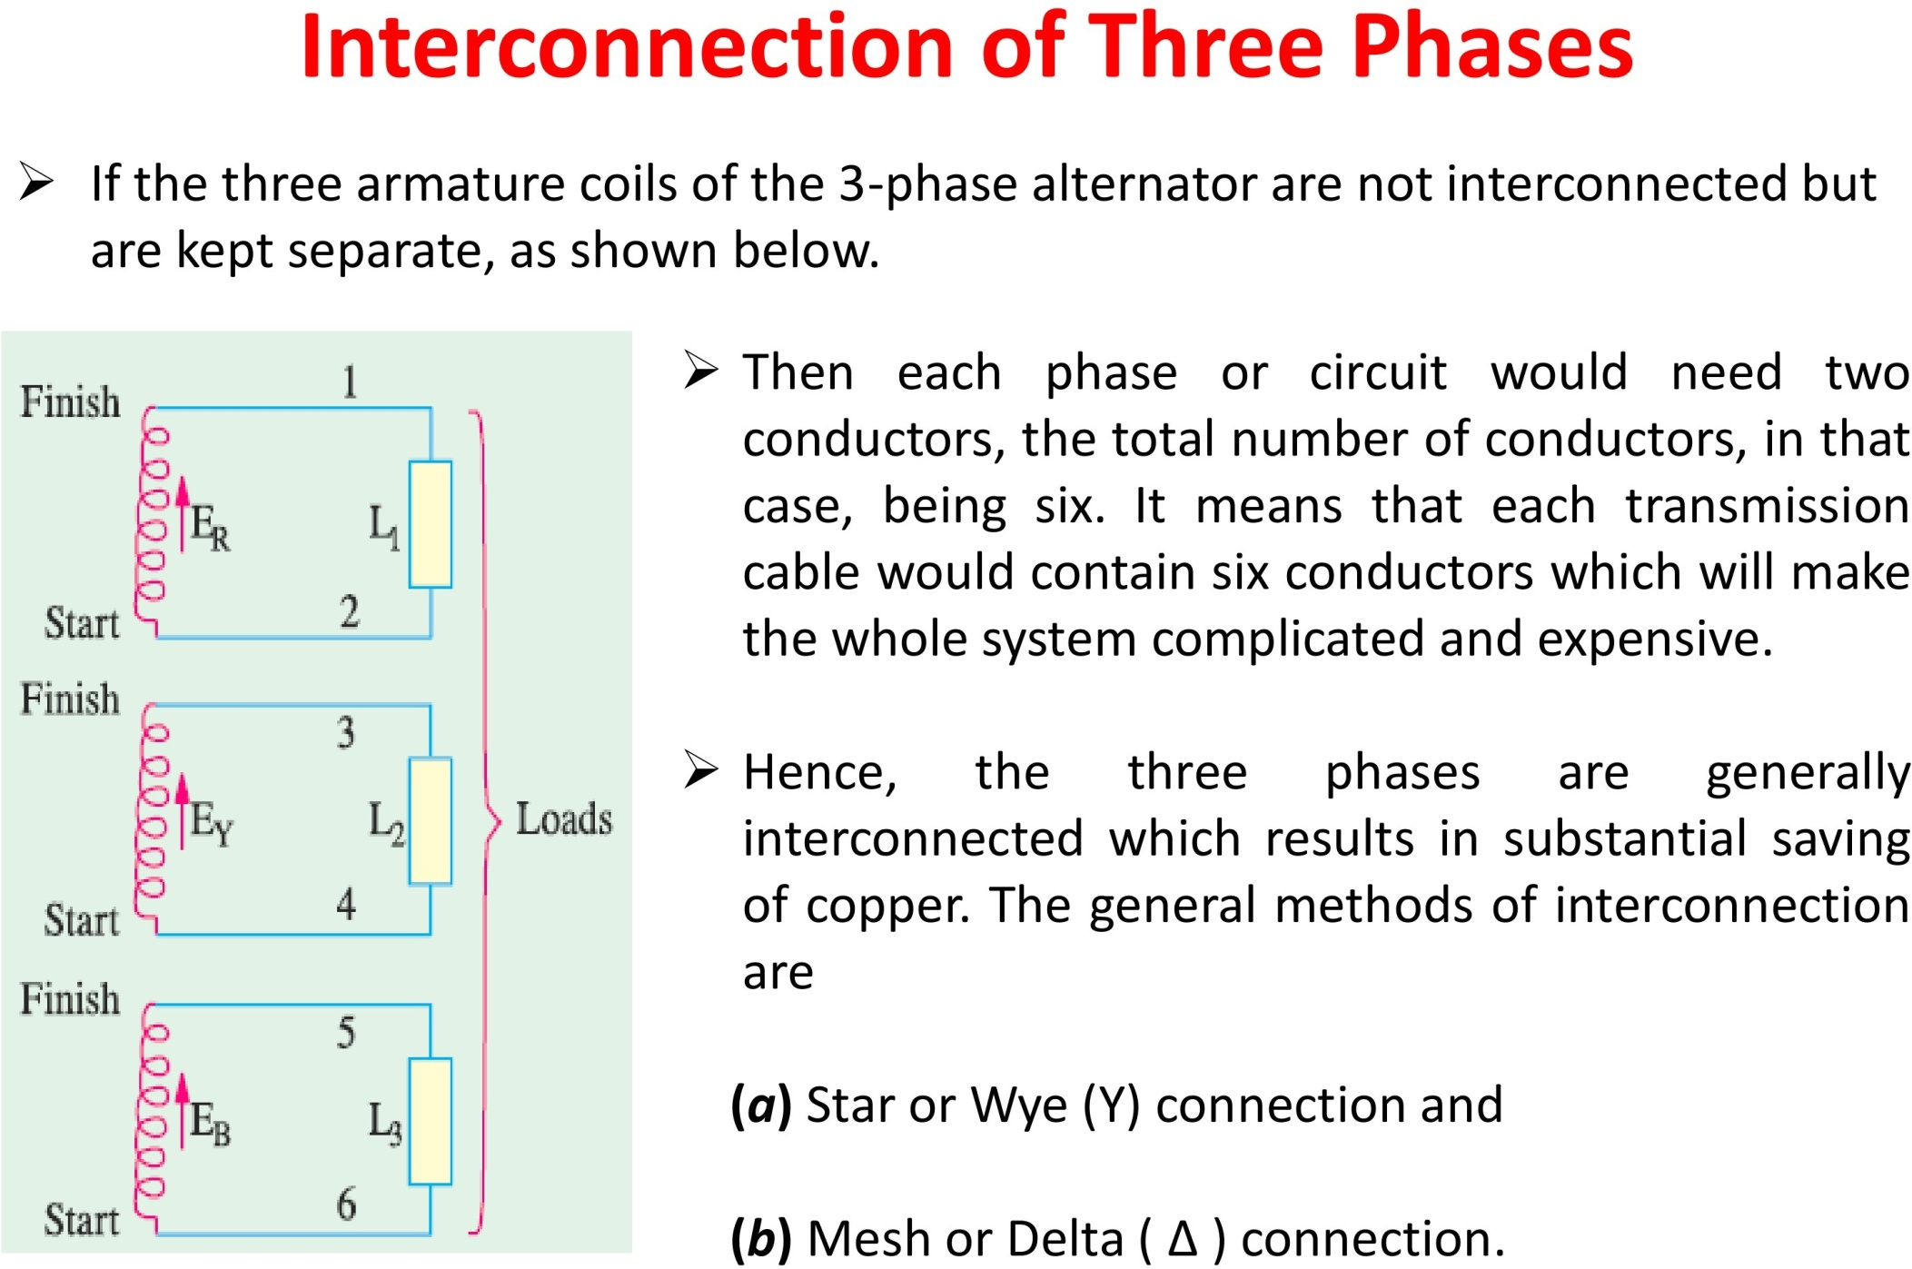

Slide 9
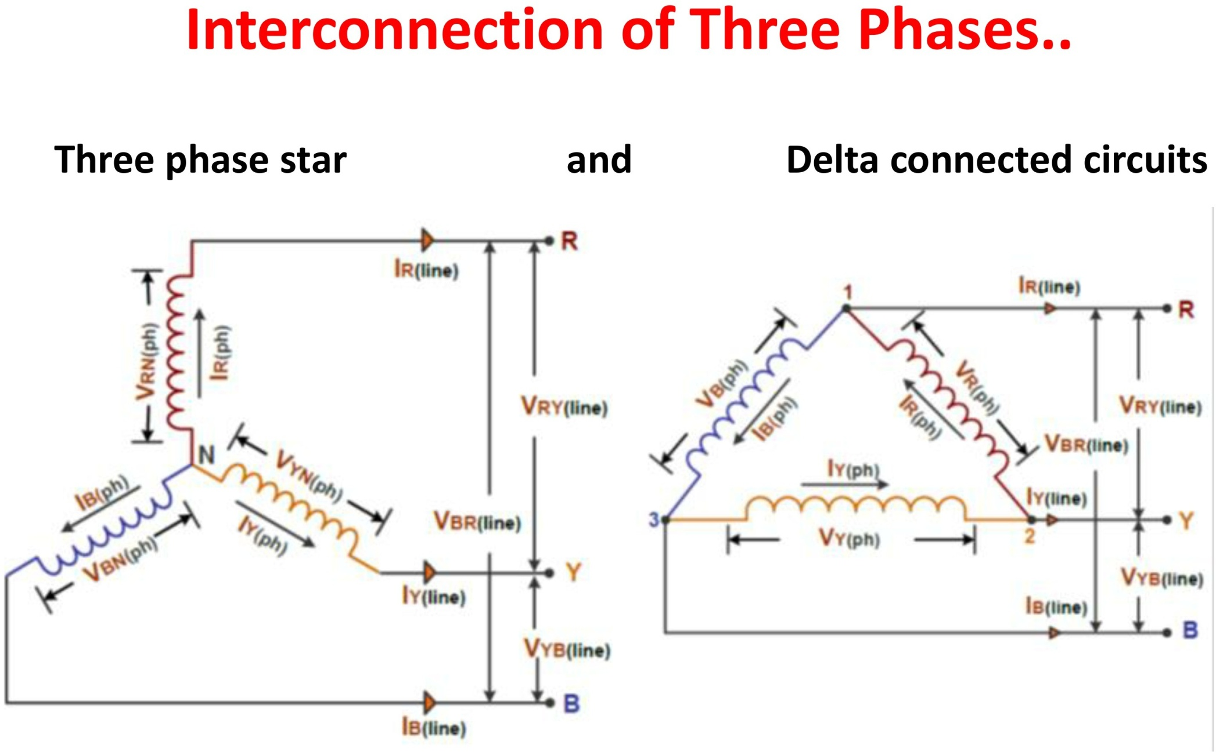

Slide 10
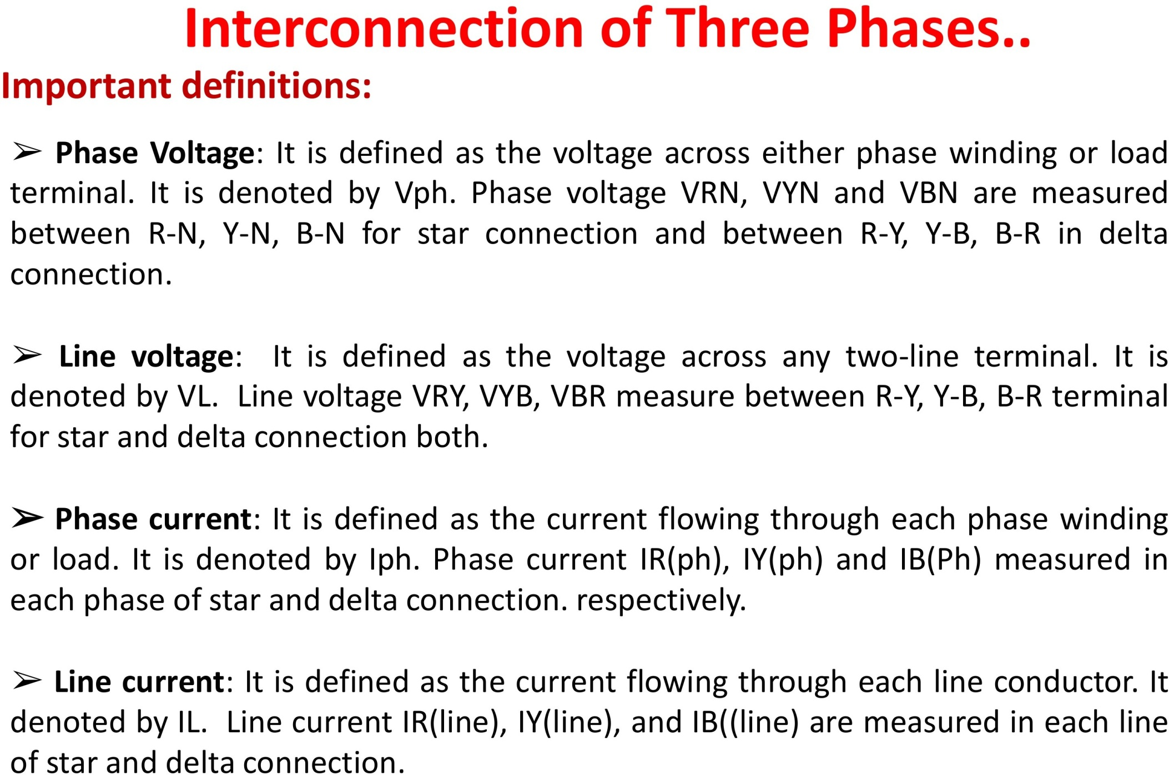

Slide 13
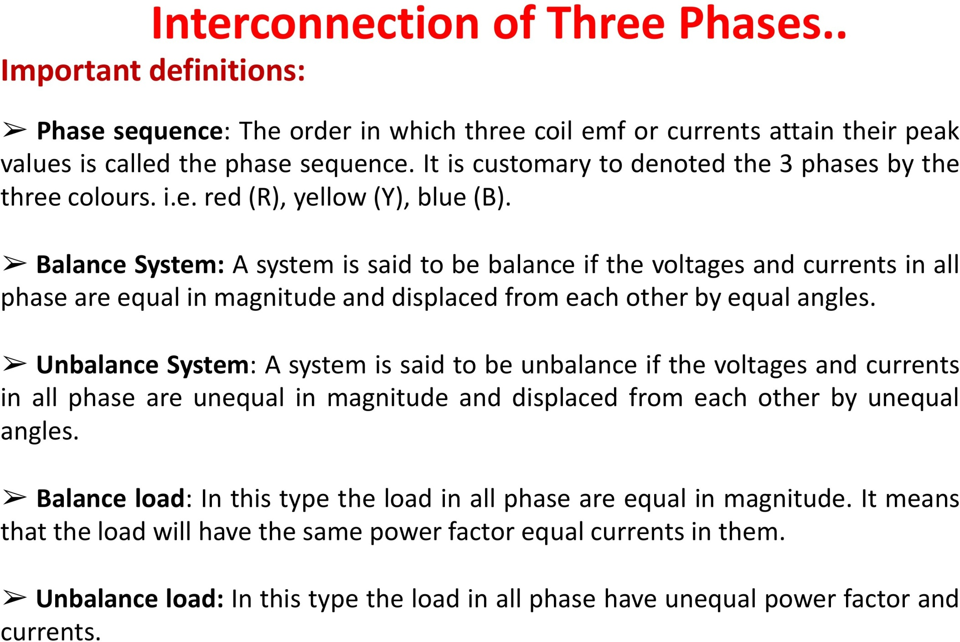

Slide 14
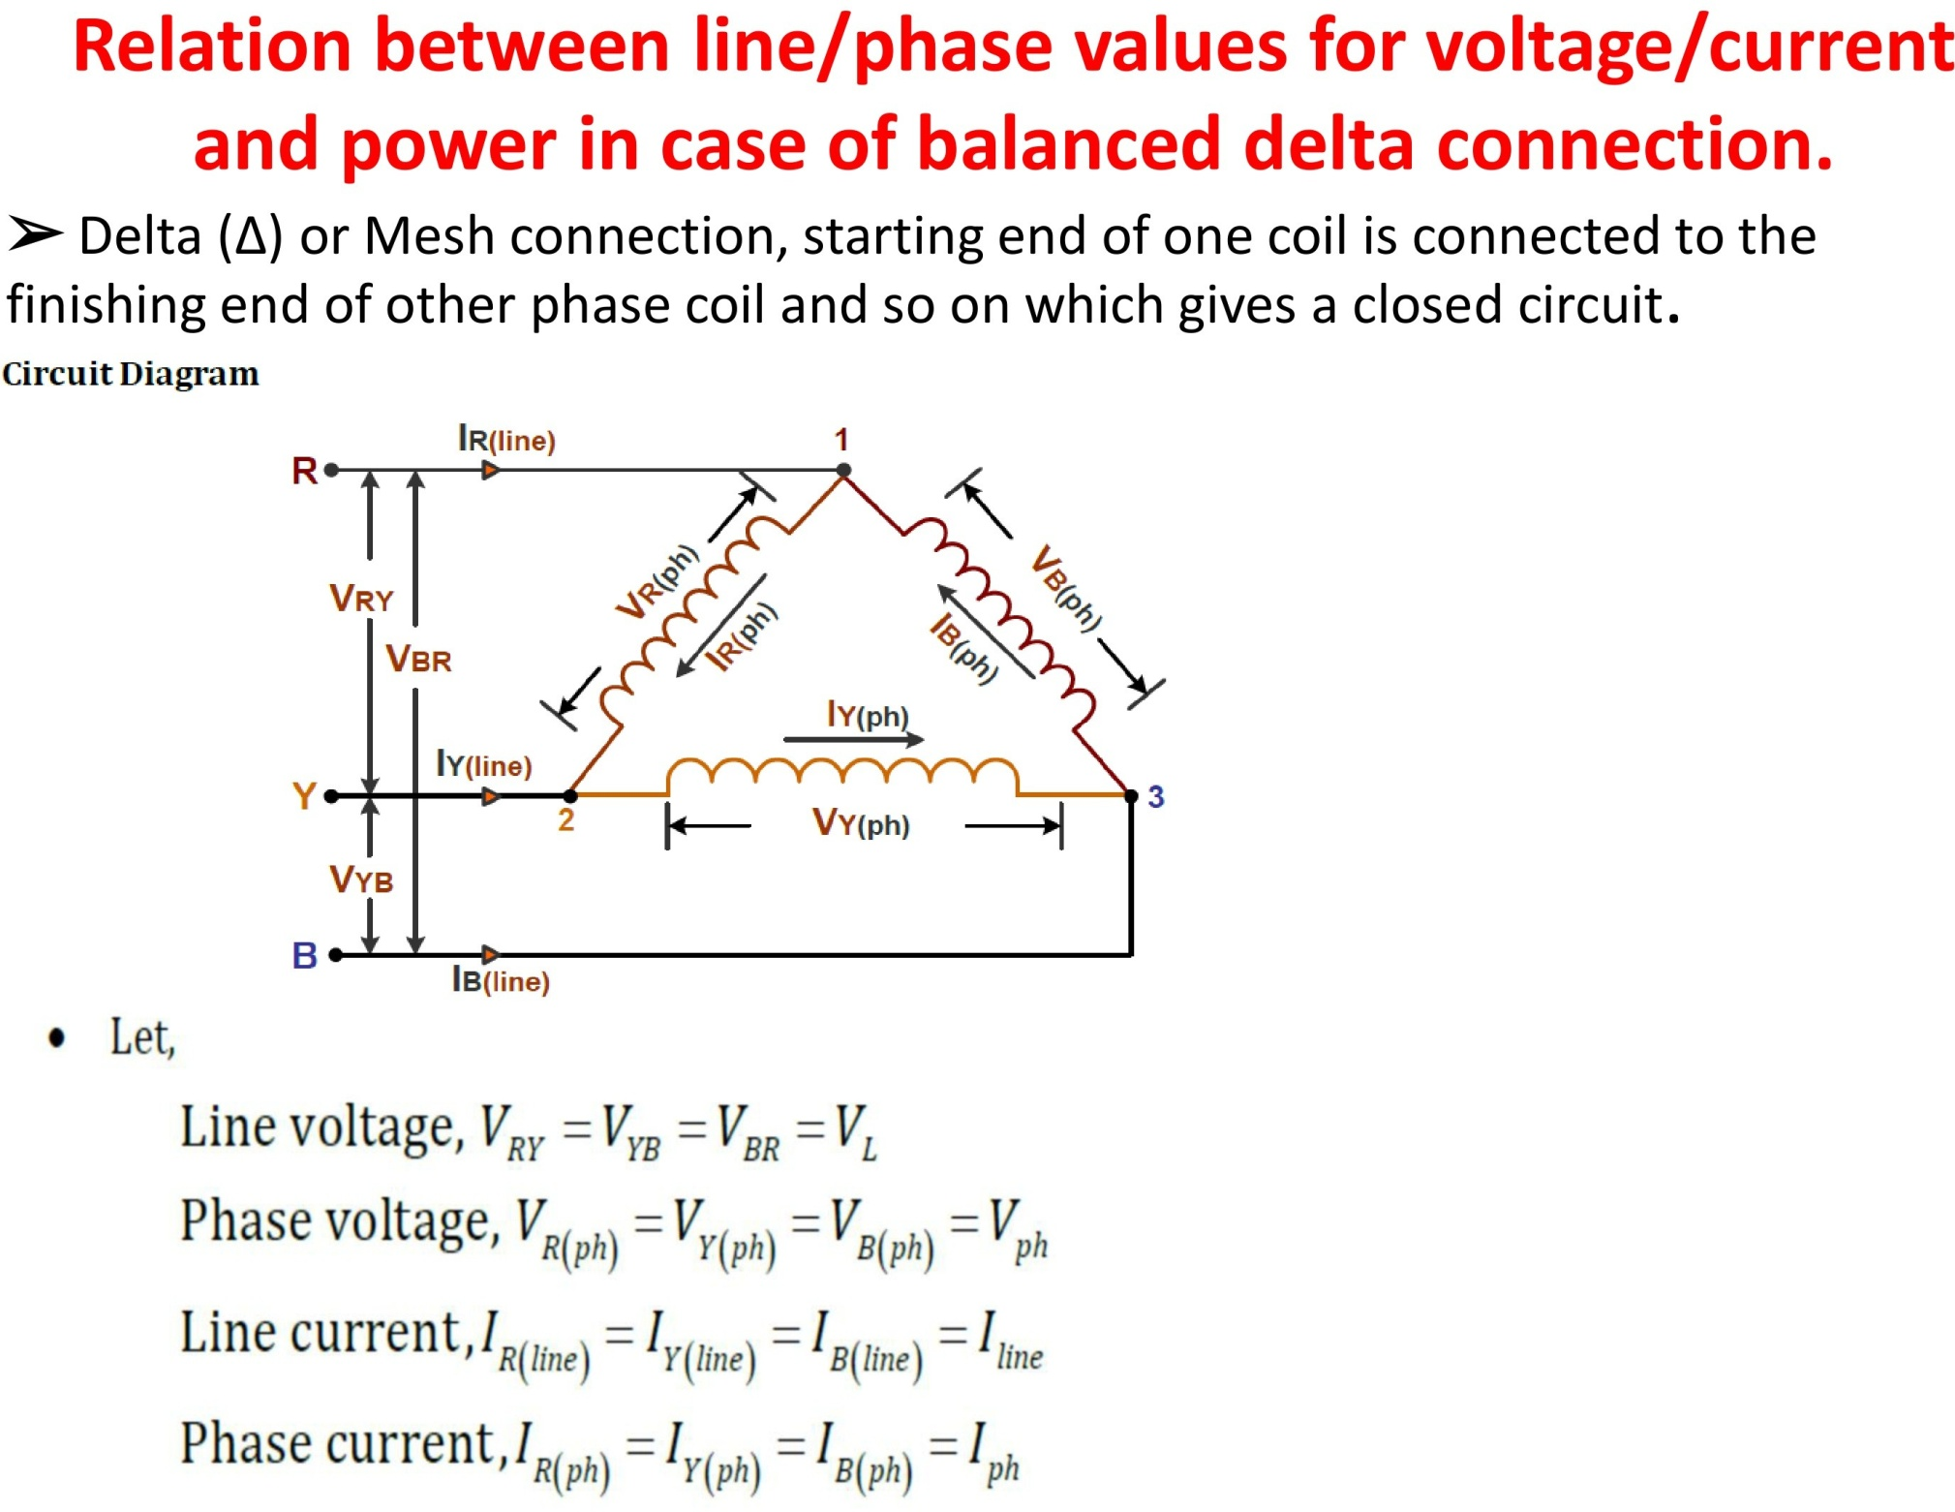



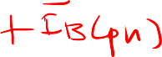



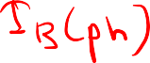





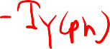



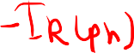


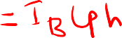


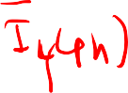

Slide 15
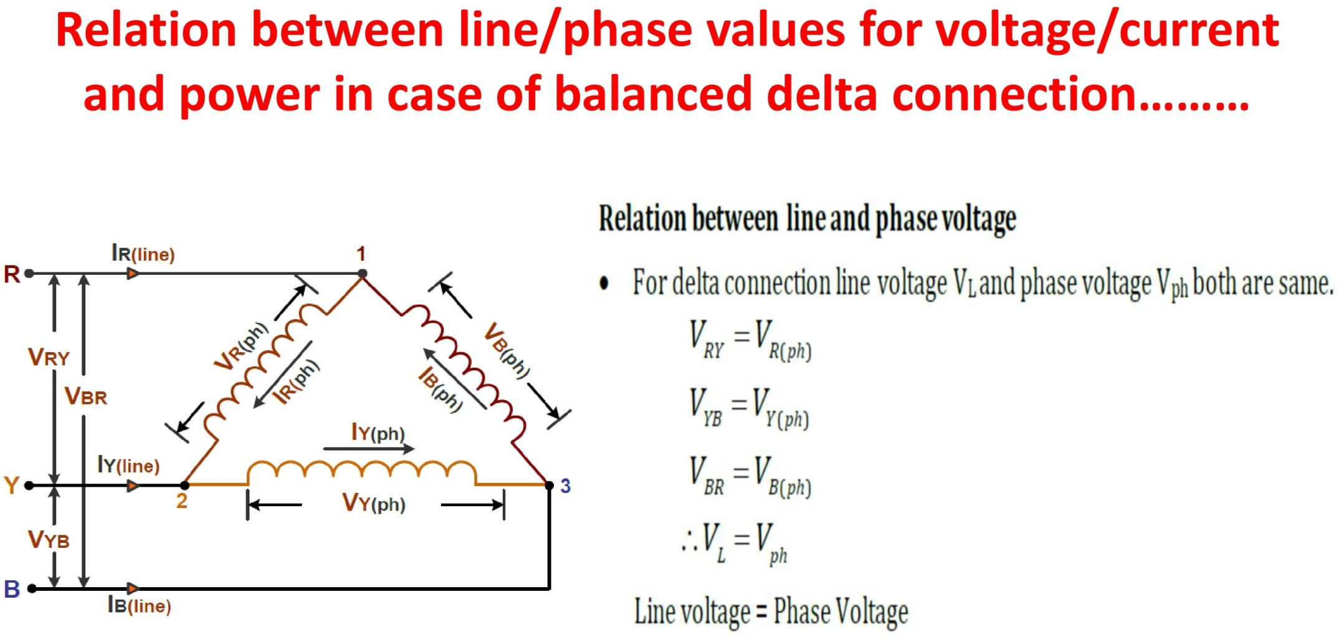

Slide 16
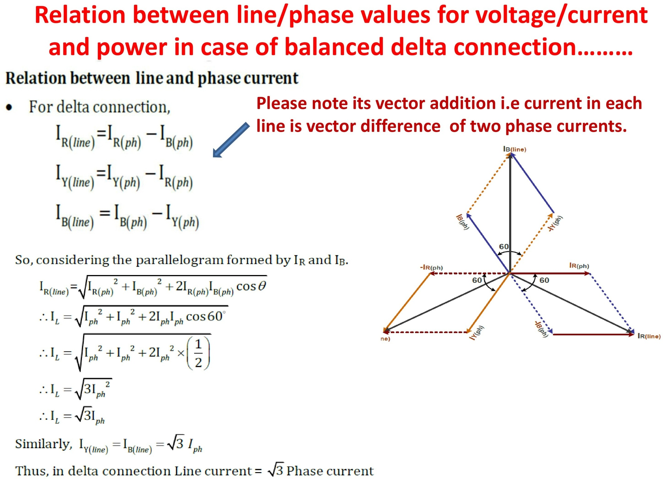


Slide 17
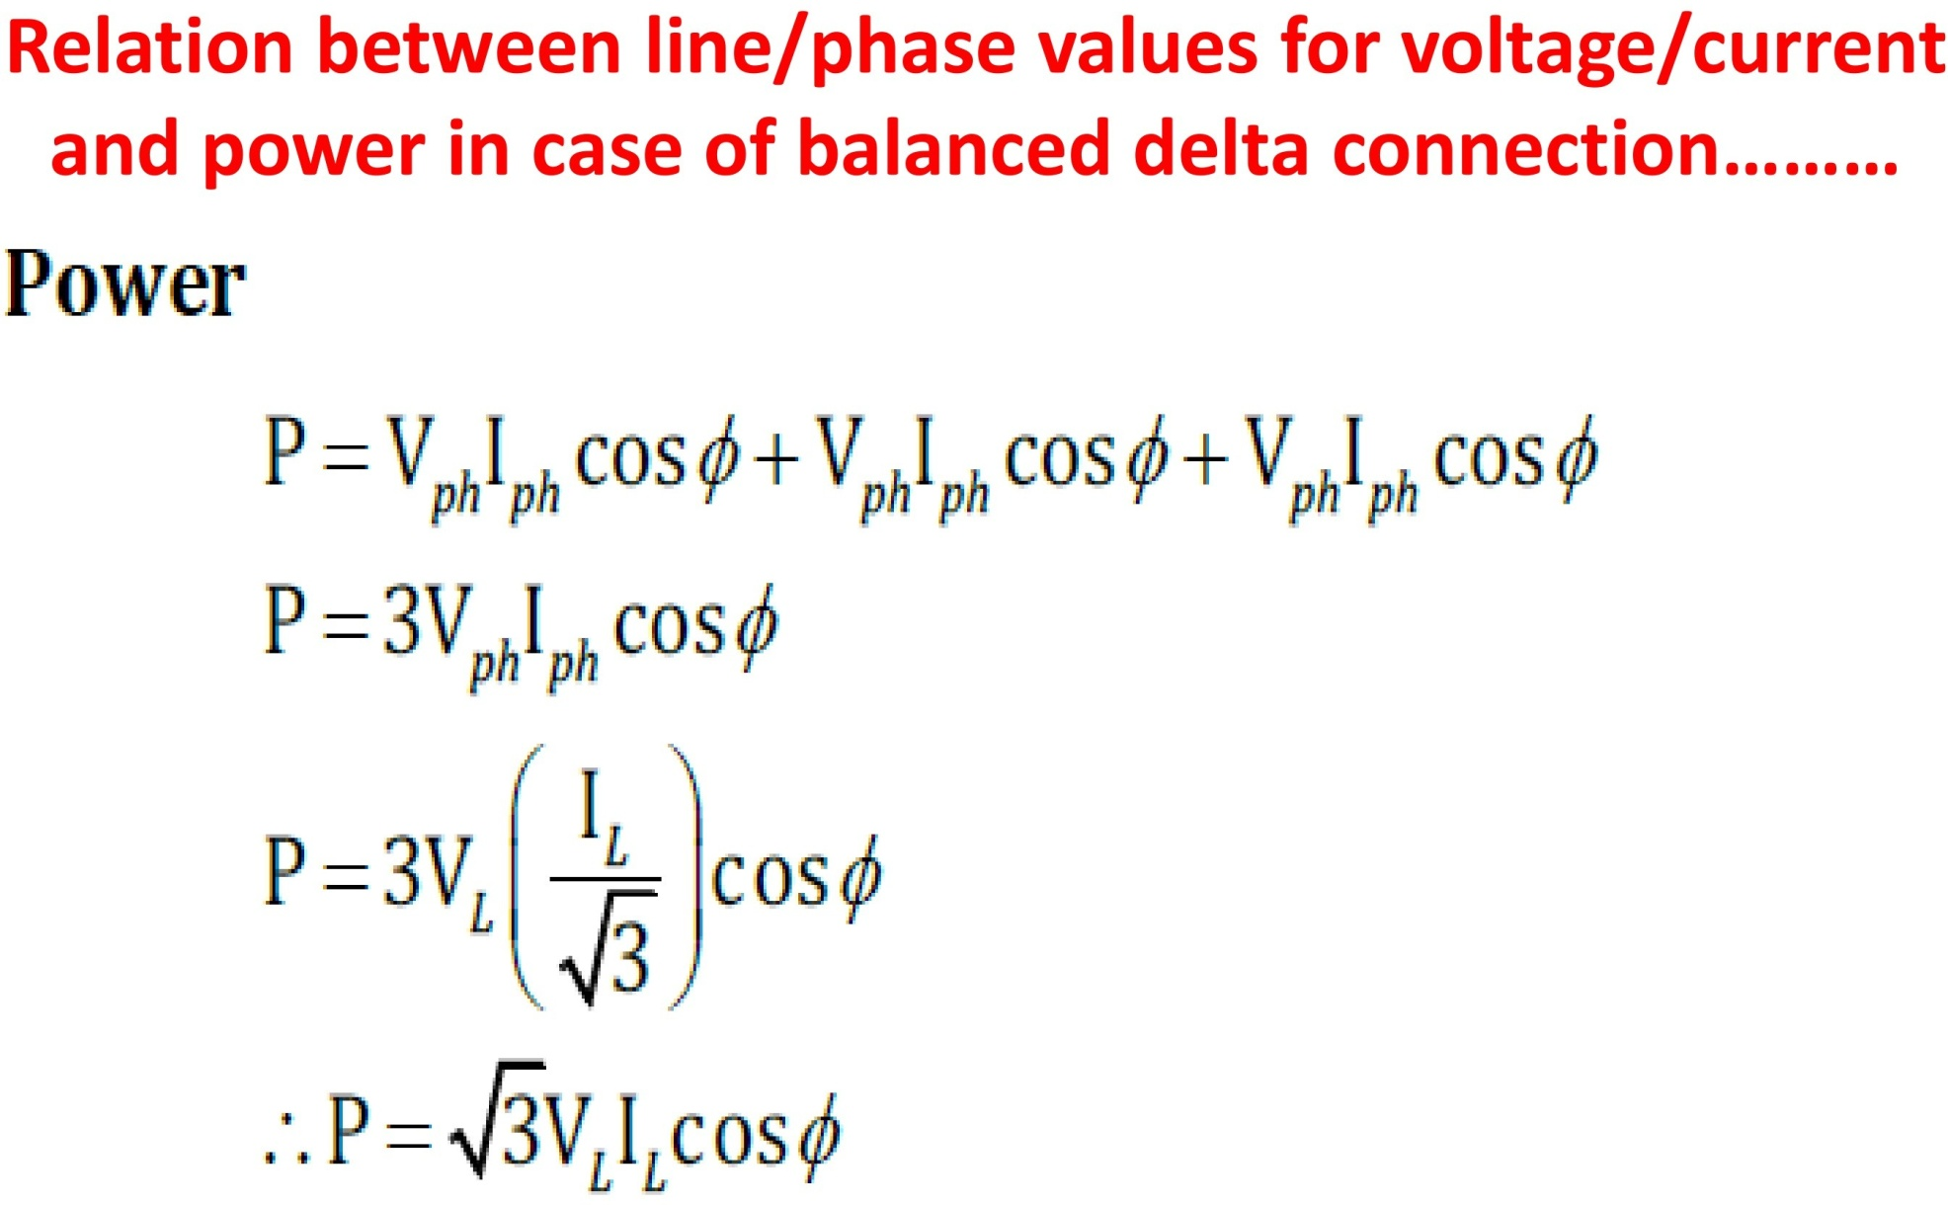

Slide 18
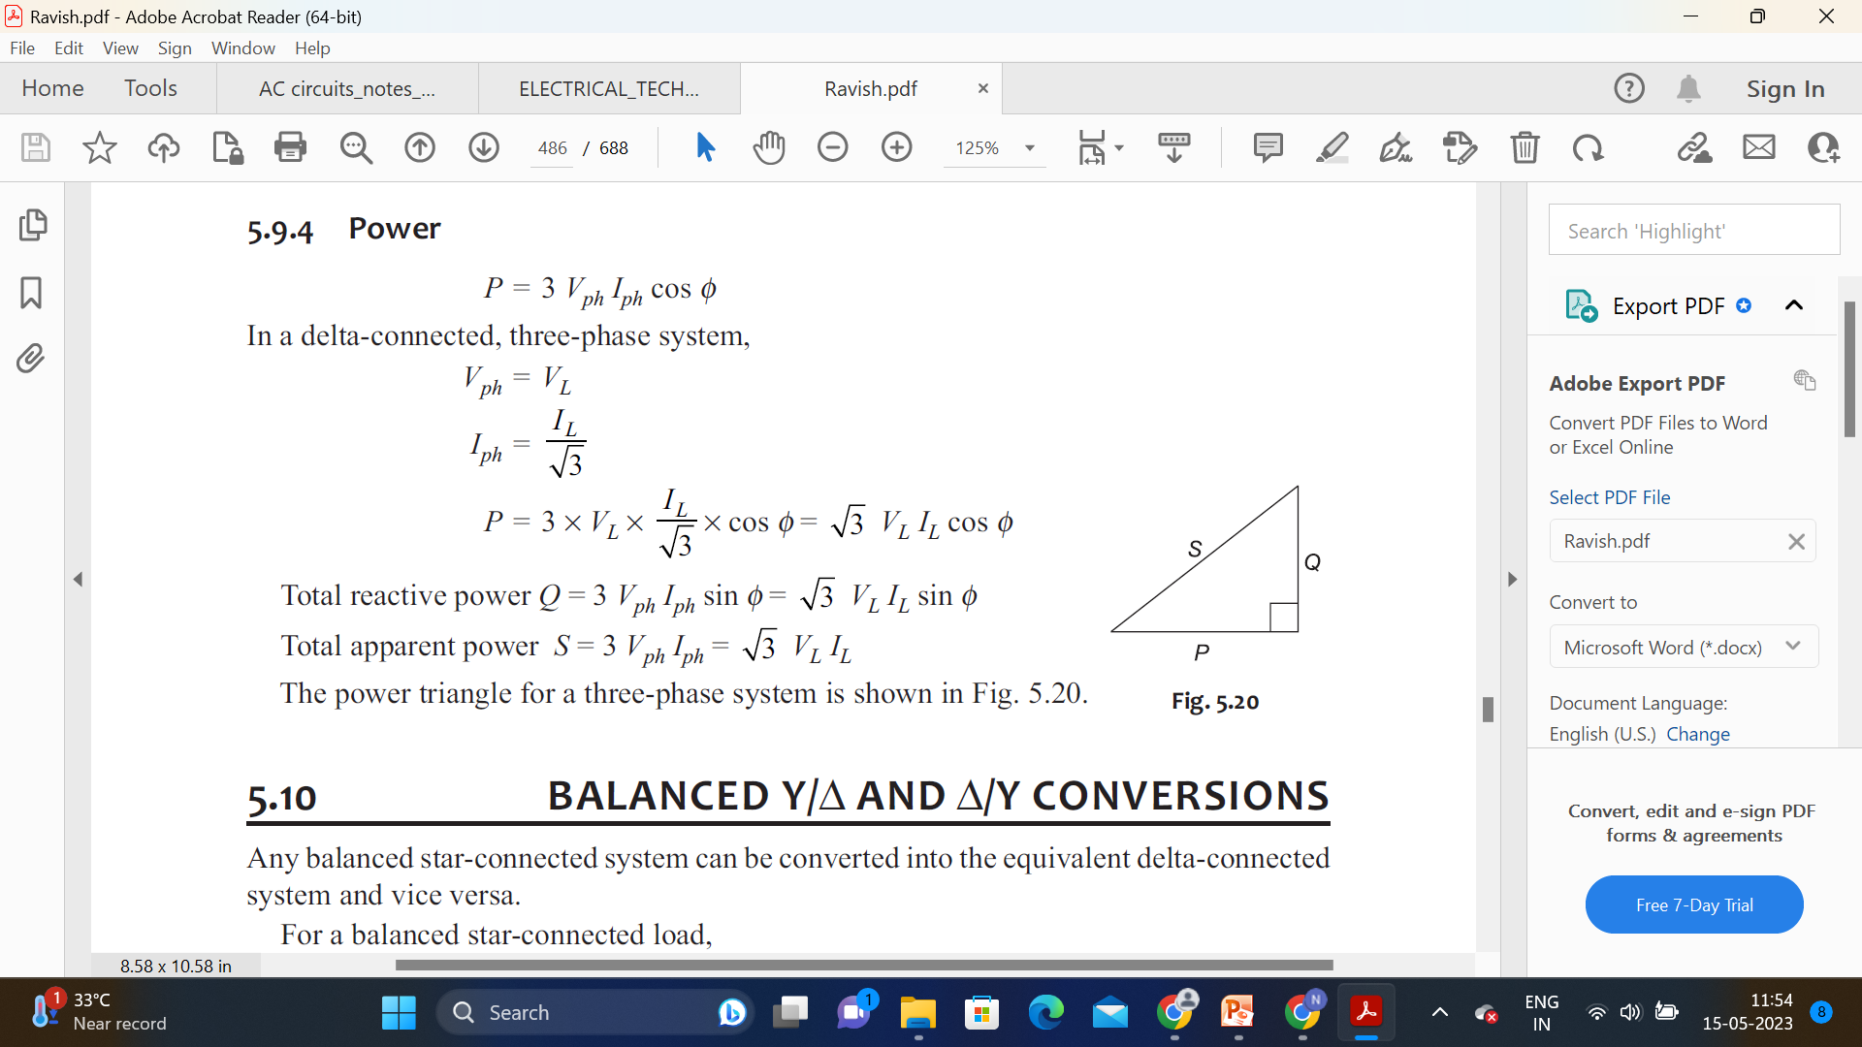

Slide 19
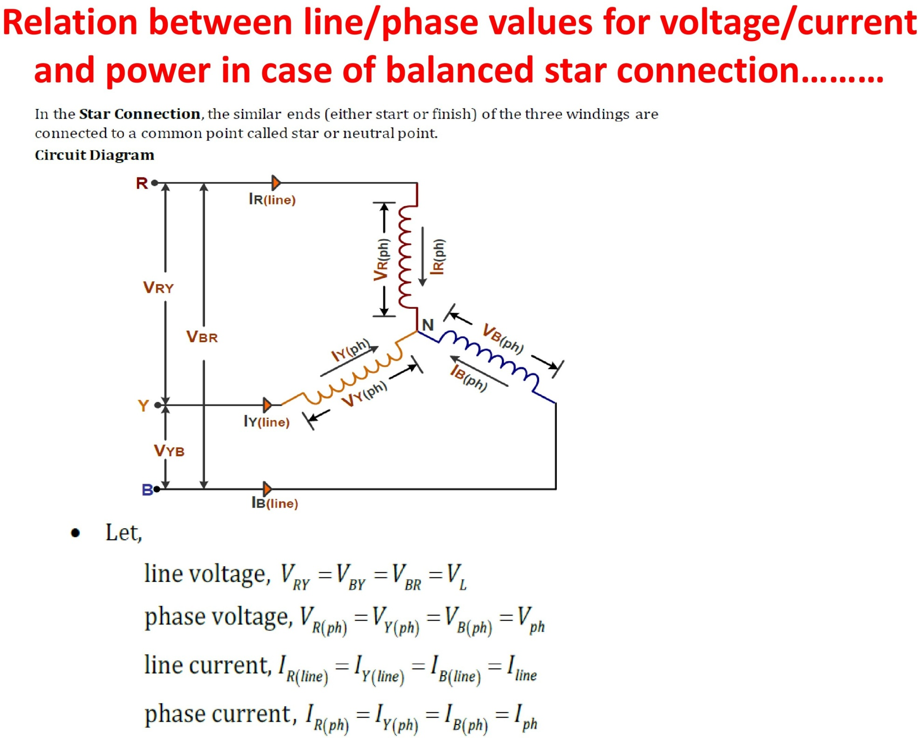

Slide 20
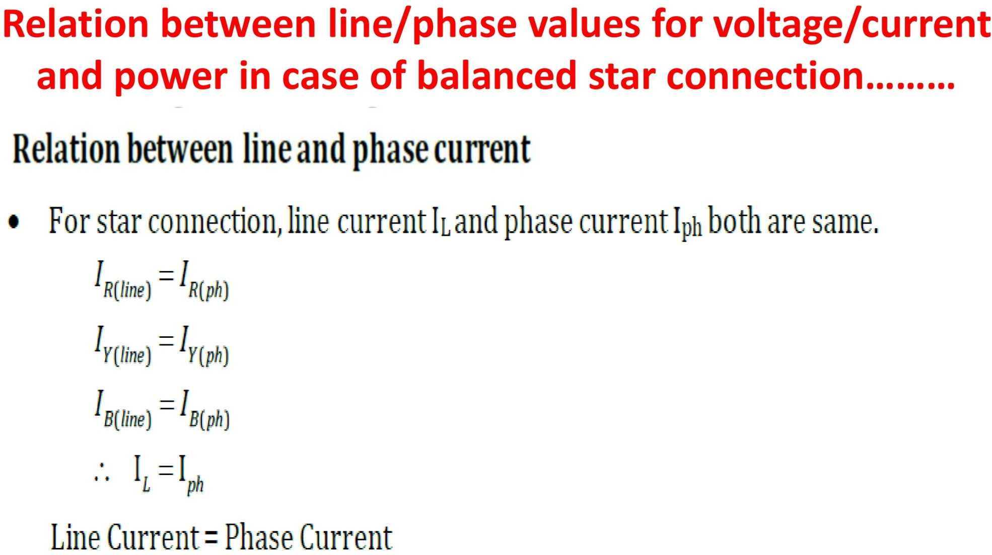

Slide 21
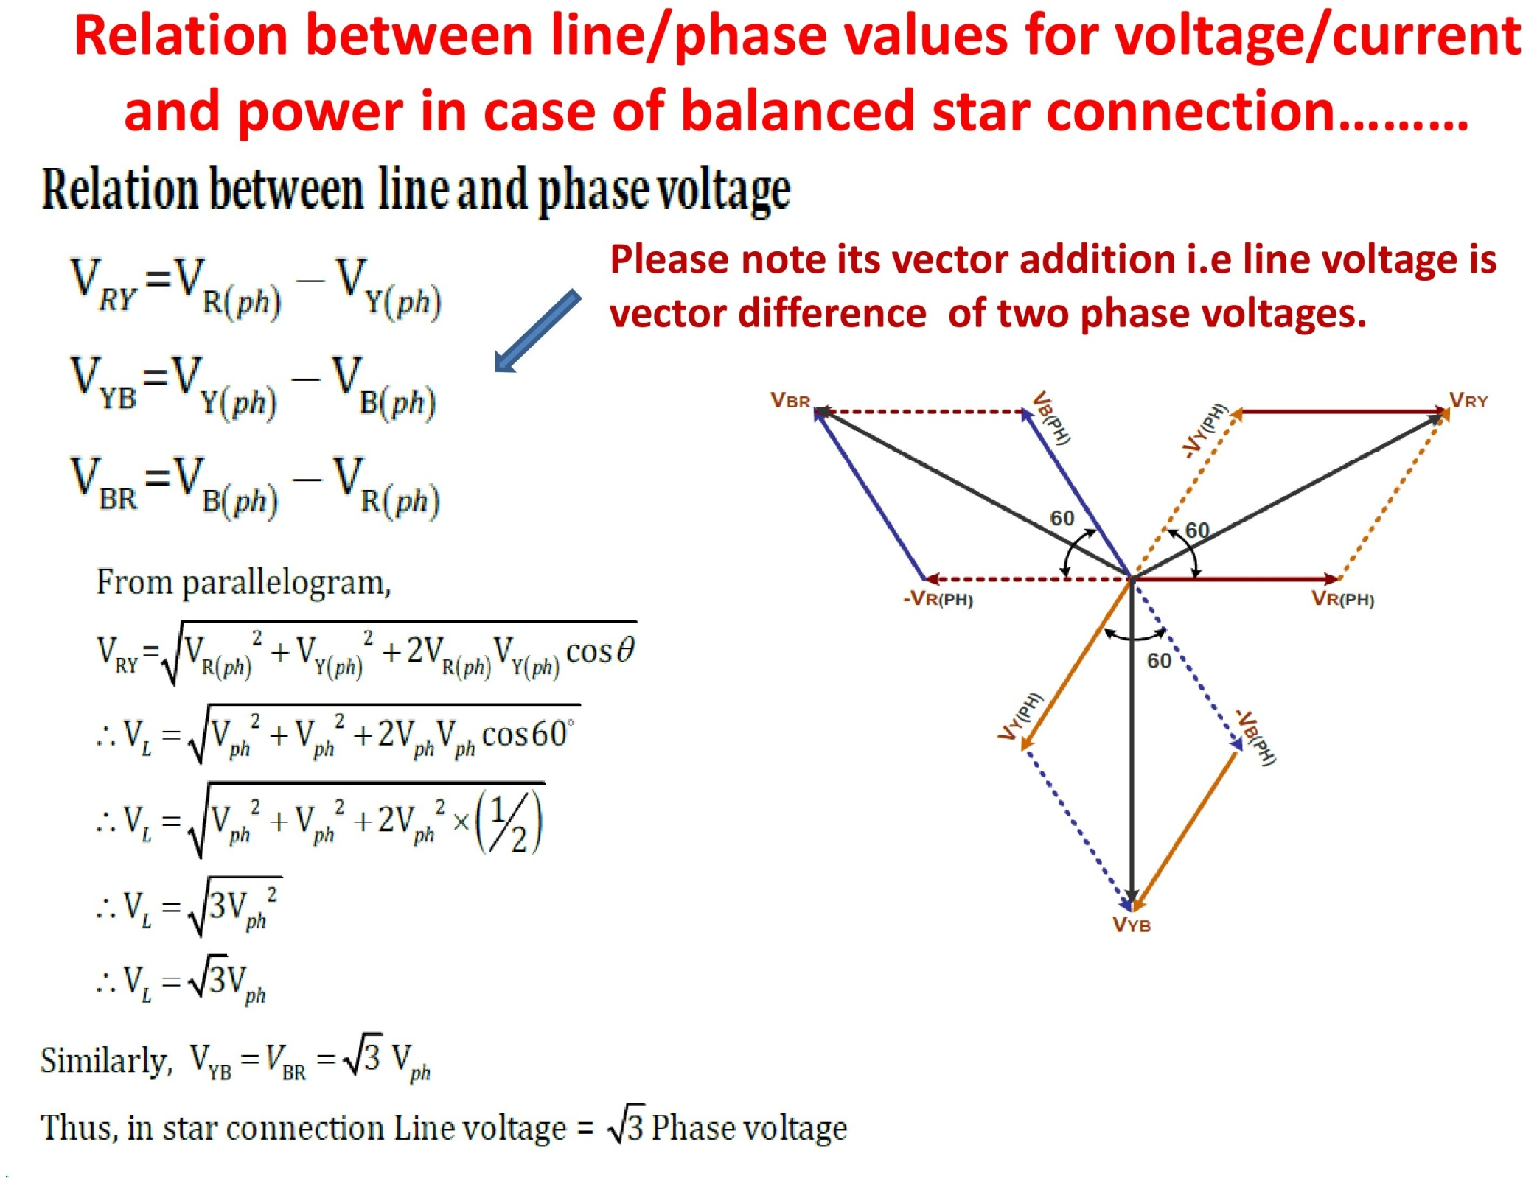

Slide 22
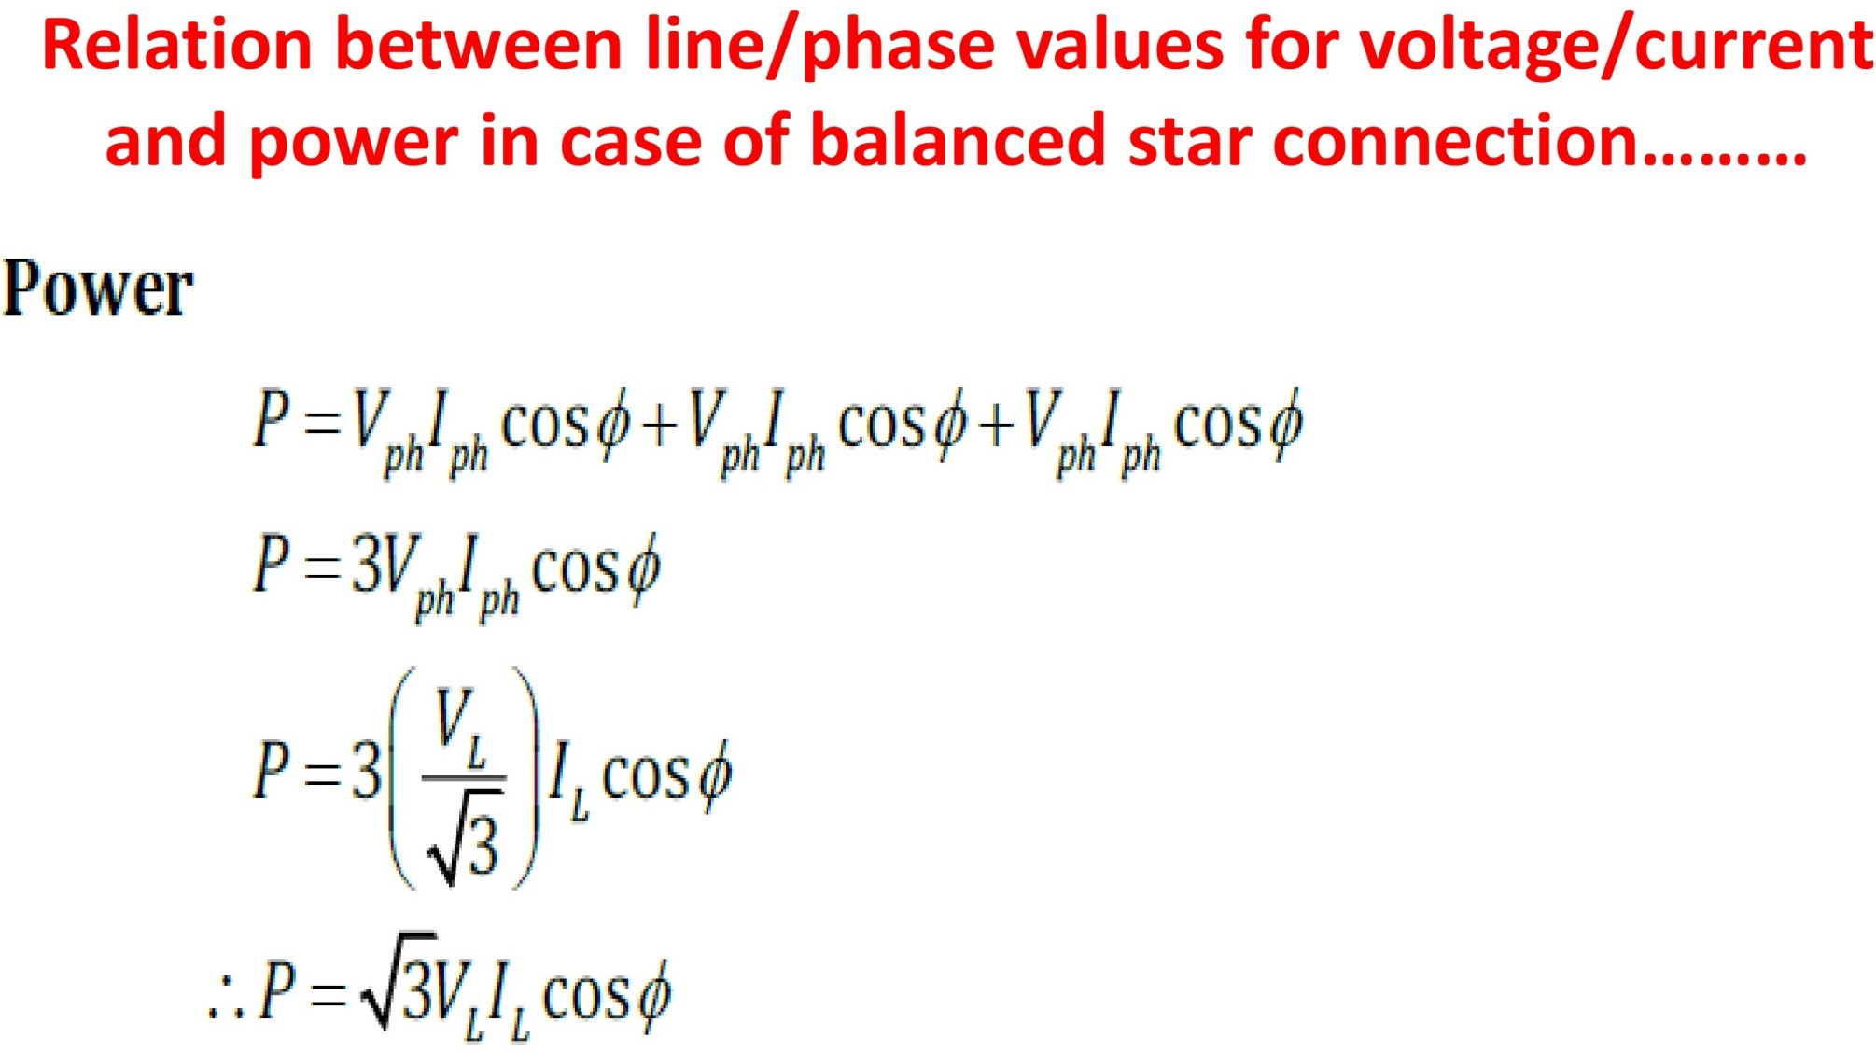









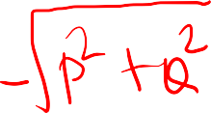



Slide 23
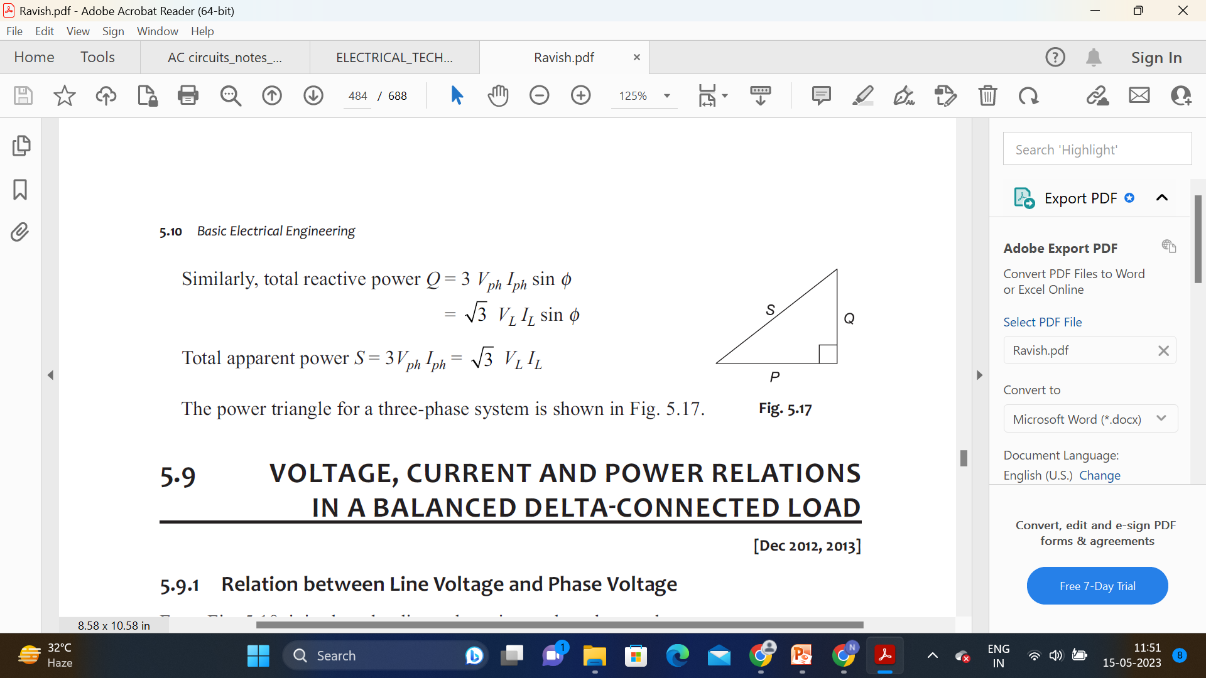

Slide 24
Difference between star and delta connection
Star Connection Delta Connection
In STAR Connection, the starting or finishing ends (similar ends) of three coils are connected together to form the neutral point. A common wire is taken out from the neutral point which is called Neutral. | In DELTA Connection, the opposite ends of three coils are connected together. In other words, the end of each coil is connected with the starting point of another coil, and three wires are taken out from the coil joints.
There is a Neutral or Star Point. | No Neutral Point in Delta Connection.
Three phase four wire system is derived from Star Connections (3-Phase, 4 Wires System). We may Also derive 3 Phase 3 Wire System from Star Connection. | Three phase three wire system is derived from Delta Connections (3-Phase, 3 Wires System). i.e. 3 Phase, Wire system is not possible in Delta Connection.
Line Current is Equal to the Phase Current. i.e. Line Current = Phase Current IL = IPH | Line Current is √3 times of Phase Current. i.e. IL = √3 IPH
Line Voltage is √3 times of Phase Voltage. i.e. VL = √3 VPH | Line Voltage is Equal to the Phase Voltage. i.e. Line Voltage = Phase Voltage VL = VPH
In Star Connection, the Total Power of three Phases P = √3 x VL x IL x CosФ …. Or P = 3 x VPH x IPH x CosФ | In delta Connection, the Total Power of three Phases P = √3 x VL x IL x CosФ …. Or P = 3 x VPH x IPH x CosФ
The speeds of Star connected motors are slow as they receive 1/√3 voltage. | The speeds of Delta connected motors are high because each phase gets the total of line voltage.
In Star Connection, the phase voltage is low as 1/√3 of the line voltage. Therefore, it needs a low number of turns, hence saving in copper and low insulation cost. | In Delta connection, The phase voltage is equal to the line voltage, hence it needs more number of turns which increase the total cost. Also high insulation cost.
Star Connection is a common and general system which is used in Power transmission. | Delta Connection is a typical system used in Distribution system and Industries.

Slide 25
Relation between star and delta (Z, power)-refer Ravish Singh

Slide 26






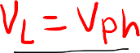
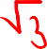


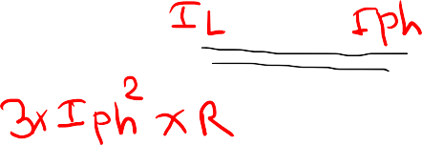




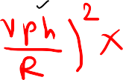


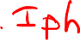



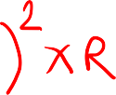




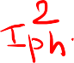





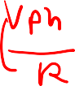

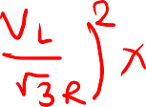


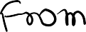









Relation between power in star and delta connected load

Slide 27
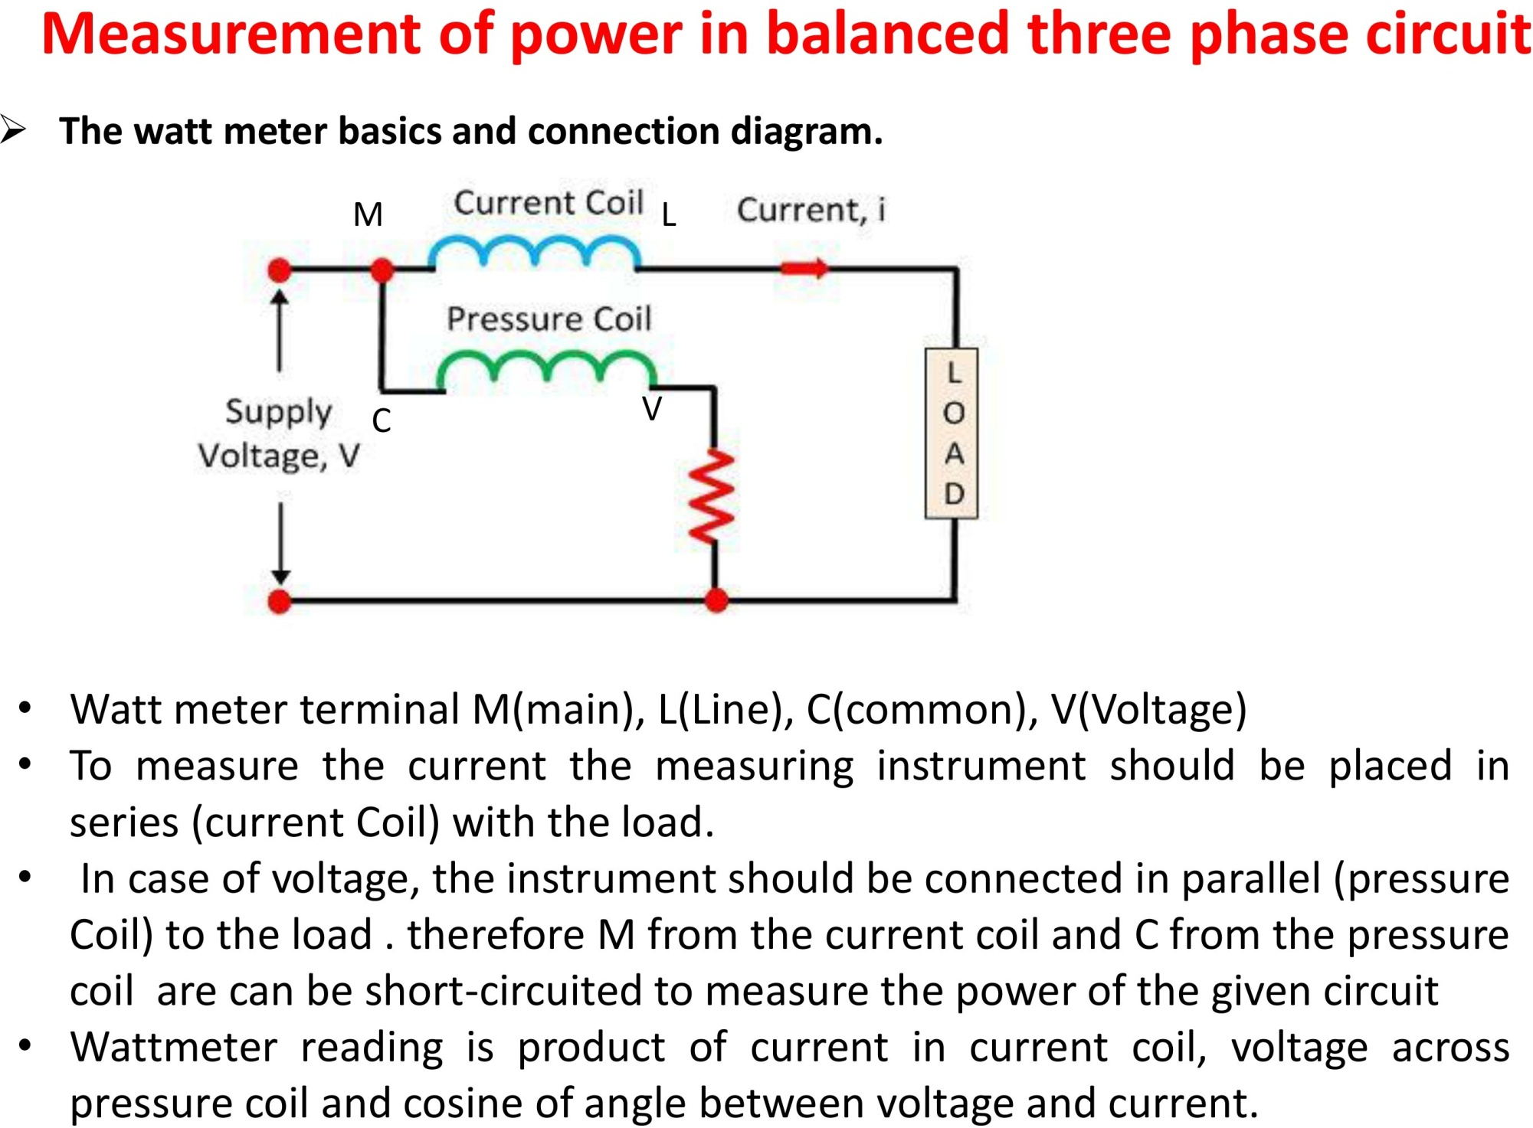

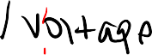
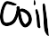


Slide 28
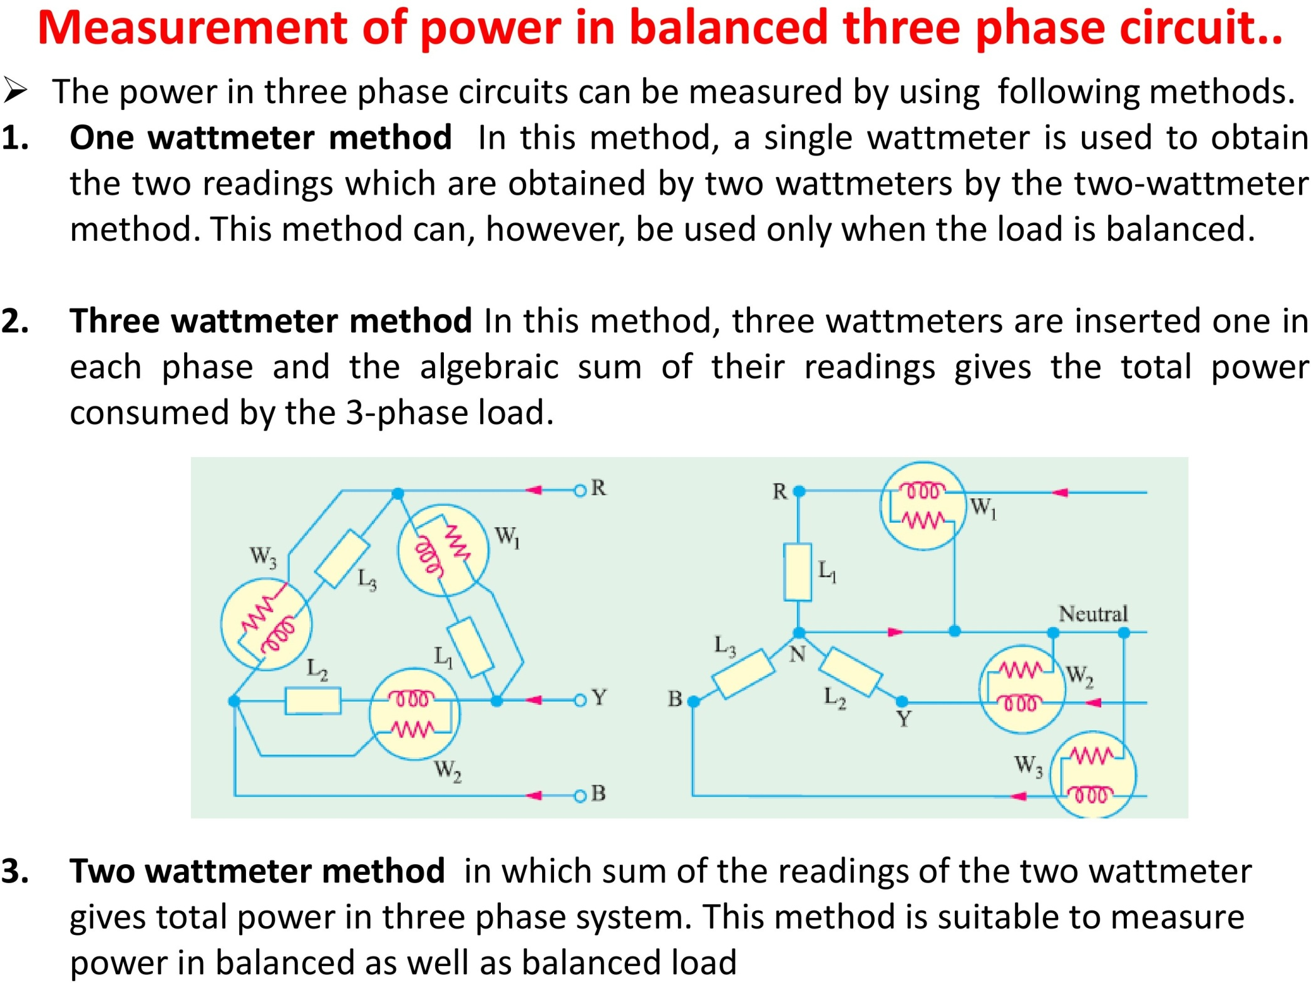
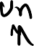

Slide 29
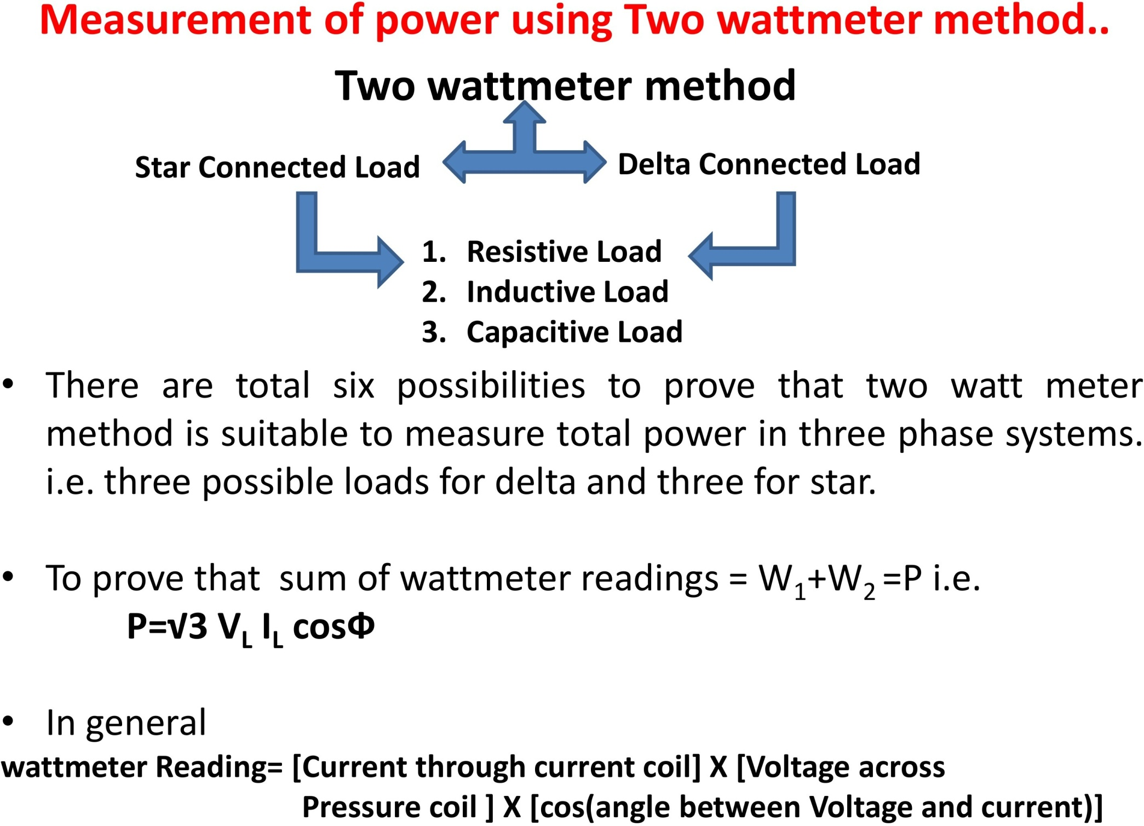

Slide 30
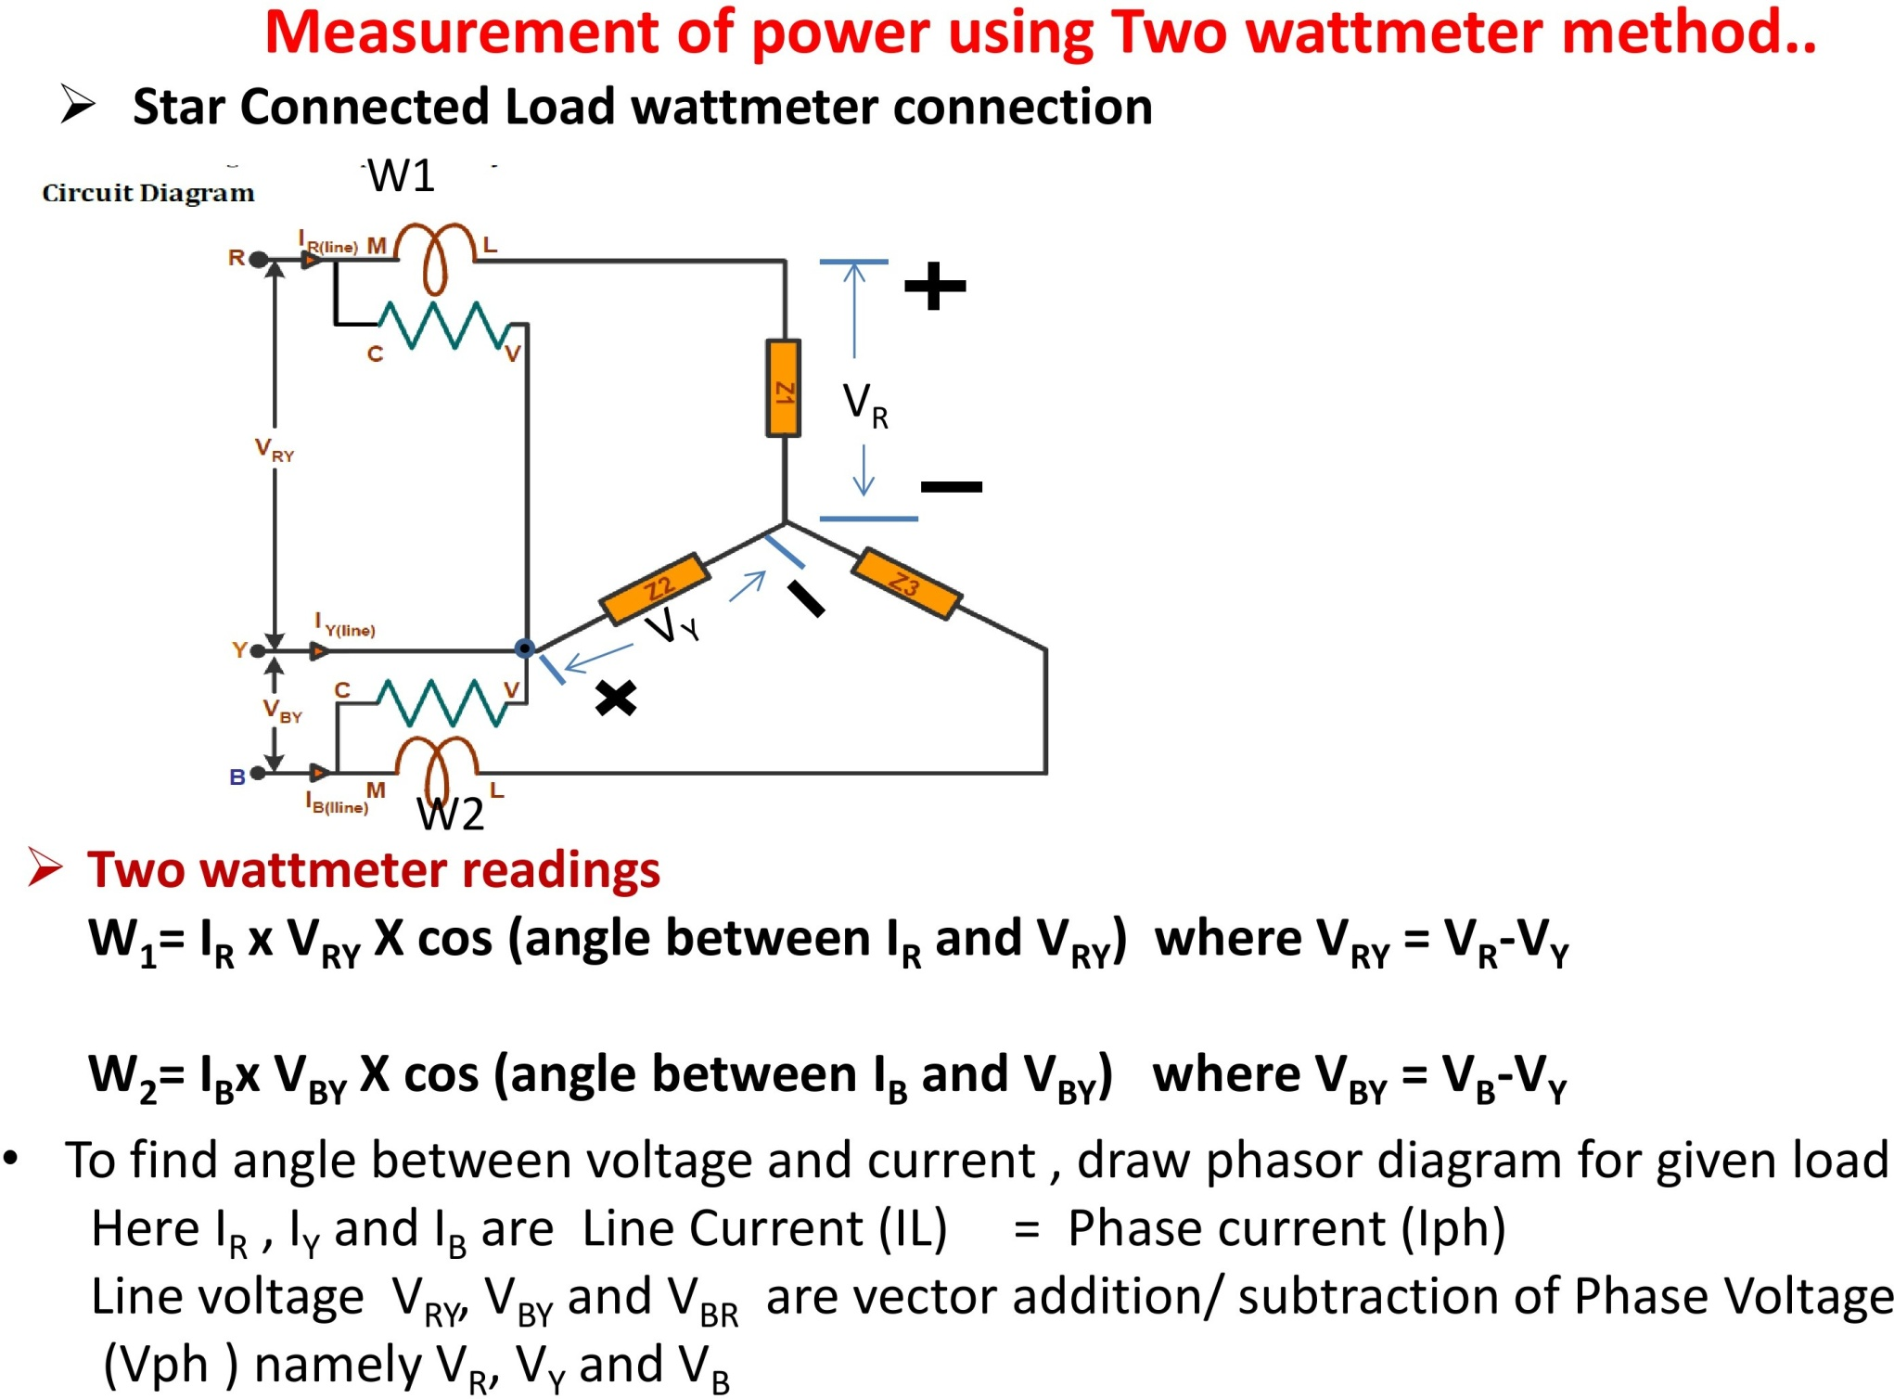



Slide 31
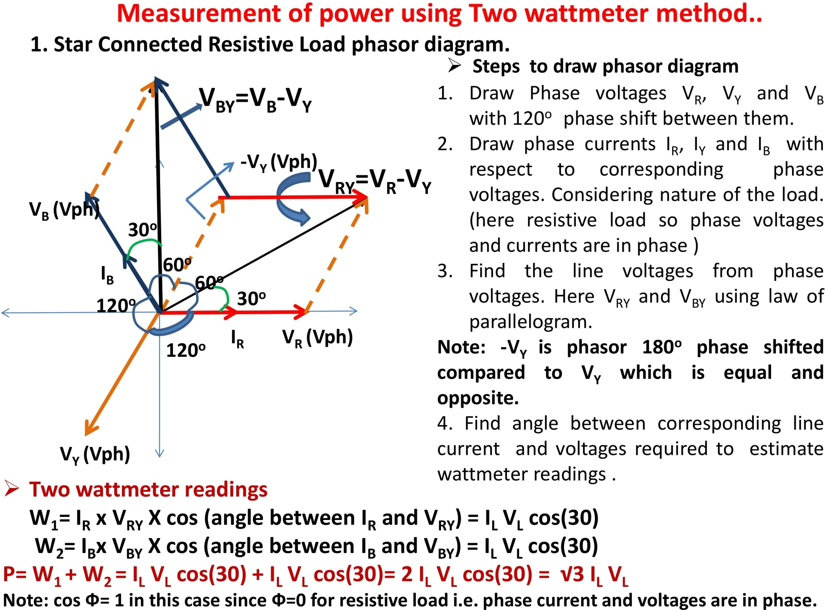

Slide 32
































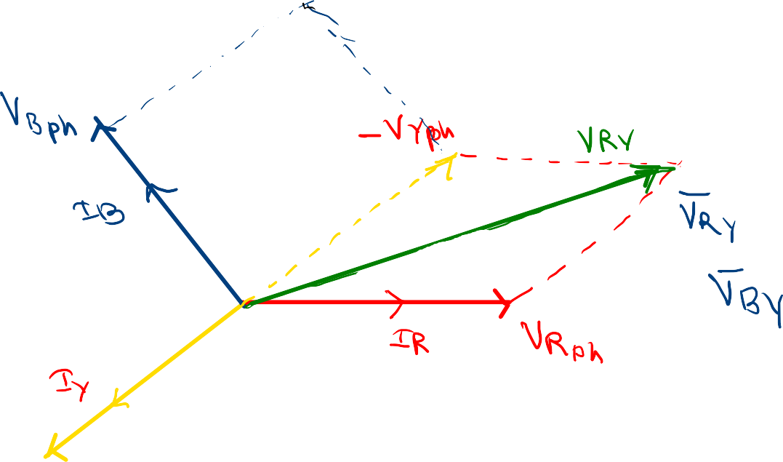
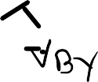
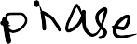


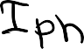

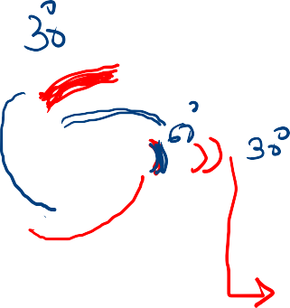
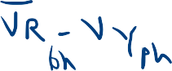






















Slide 33


Slide 34


































Slide 36



Slide 37



Slide 38





Slide 39



Slide 40





























3.
(Here for capacitive load phase voltages will lag phase current by angle )

Slide 41



















Slide 43


Slide 44
























Example:- 1 The input to a 3-phase a.c. motor is measured as 5kW. If the voltage and current are 400 V and 8.6 A, respectively, determine the power factor of the system.

Slide 45













































































Example:-2 Three identical coils, each of resistance 10 Ohm and inductance 42 mH are connected (a) in star and (b) in delta to a 415 V , 50 Hz , 3 phase supply. Determine the total power dissipated in each case.

Slide 46























































Example:3 A 400 V , 3-phase star connected alternator supplies a delta-connected load with coil having resistance of 30 Ohm and inductive reactance 40 Ohm. Calculate (a) the current supplied by alternator (b)the output power and the kVA of the alternator, neglecting losses in the line between the alternator and load.

Slide 47
































Example:-5 Two wattmeters are connected to measure the input power to a balanced 3-phase load by two wattmeter method. If the wattmeter readnings are 8kW and 4kW. Determine (a) the total input power and (b) the load power factor.

Slide 48





































Example 6: Two wattmeter connected to a three phase motor indicate the total power input to be 12 kW. The power facctor is 0.6. Determine the readings of each wattmeter.

